Slide 1
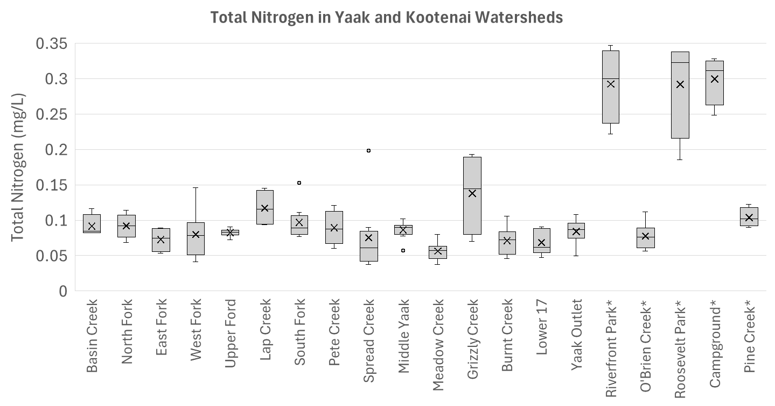
Northern Rockies
90th = 0.167 mg/L
median = 0.041 mg/L
25th = 0.018 mg/L

Slide 2
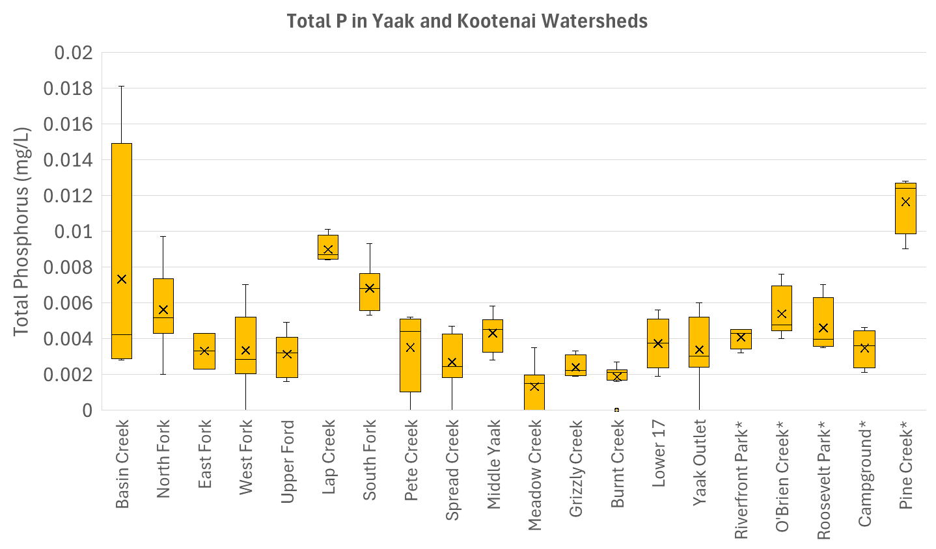
Northern Rockies
90th = 0.013 mg/L
median = 0.006 mg/L
25th = 0.004 mg/L

Slide 3
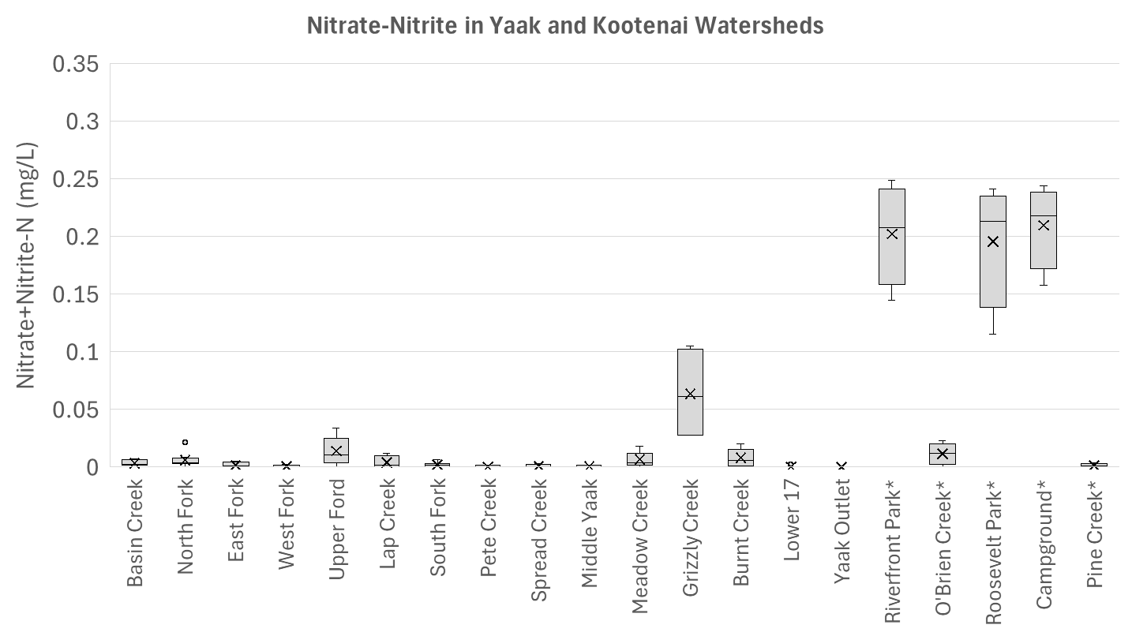

Slide 4
