Slide 1
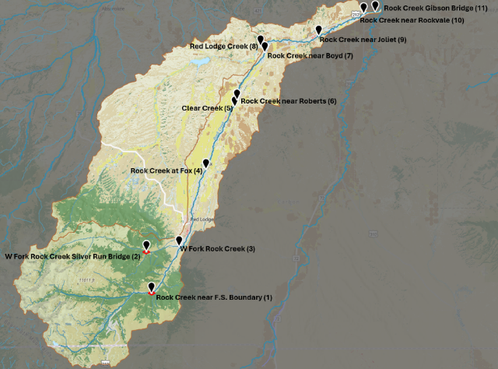




Carbon County Resource Council
2022-2024 Rock Creek
Water Quality Data Analysis
Samuel Gabrielson & Wesley Cousin
G Jawer
Dr. Adam Sigler
Notes:
Thank you for joining us today! This work has been conducted as part of a one semester Montana State University undergraduate research course, led by Dr. Adam Sigler with support from me, Gabrielle Jawer. Samuel Gabrielson and Wesley Cousin are the undergraduate students who analyzed the volunteer collected monitoring data, and they’ve done some amazing work this semester.
This project was conducted in consultation with representatives of the Carbon County Resource Council, and it was supported by funding and comments from Montana Department of Environmental Quality (MDEQ).
Rock Creek is a 55-mile-long tributary to the Clarks Fork Yellowstone River. It begins high in the Absaroka Beartooth Wilderness and flows through National Forest Land, as well as the towns of Red Lodge, Fox, Roberts, Joliet, and Boyd. It also flows through multiple subdivisions, farms, and ranches before merging with the Clarks Fork Yellowstone River south of Laurel, MT. Rock Creek runs along highway 212 for most of its length with adjacent land uses including residential development, cultivated crops, and pasture/hay land. Red Lodge Creek and Clear Creek are additional tributaries covered under this project.

Slide 2
Project Goals
To investigate nutrient concentrations in Rock Creek as they relate to site location in the basin, agricultural activities, and development.
To investigate chemical and physical parameters in Rock Creek as they relate to site location, agricultural activities, development and other land uses.
To investigate stream temperature in Rock Creek at 3 locations. One at Fox, Boyd and Joliet.
To investigate total suspended solids in Rock Creek as they relate to sediment source areas and seasonal activities.
Notes:
CCRC collects water quality data by participating in Monitoring Montana Waters (MMW) Volunteer Water Quality Program. The group’s mission is to provide useful data to promote better stewardship of Rock Creek. Each sampling project is guided by a Sampling and Analysis Plan. CCRC’s 2024 Sampling and Analysis Plan included these four goals: (read goals)

Slide 3
Parameter | Start Date | End Date | Sites Sampled | Number of Samples
Nitrate-N | 2022-05-02 | 2024-10-27 | 11 | 216
Nitrogen, Total | 2022-05-02 | 2024-10-27 | 11 | 216
Phosphorus, Total | 2022-05-02 | 2024-10-27 | 11 | 216
Total Suspended Solids | 2022-05-02 | 2024-10-27 | 11 | 216
Phosphorus, Ortho | 2023-04-23 | 2024-10-27 | 11 | 144
Specific Conductance, Meter | 2023-04-23 | 2024-10-27 | 11 | 152
Temperature, Water | 2023-04-23 | 2024-10-27 | 11 | 152
Dissolved Oxygen, Conc | 2023-05-28 | 2024-10-27 | 11 | 141
Turbidity | 2023-05-28 | 2024-10-27 | 11 | 140
pH, Meter | 2023-05-28 | 2024-10-27 | 11 | 141
Notes:
To accomplish these goals, CCRC made field measurements and collected water samples at 11 sites analyzing samples for the parameters shown, starting in 2022. We downloaded their data from the National Water Quality Exchange, where it’s uploaded for long term storage. Here’s a quick table to show an overview of the data we analyzed in this project.

Slide 4
Notes:
The group’s 11 sampling sites are shown here.

Slide 5
DNRC flow gage
USGS flow gage
Notes:
There is a DNRC flow gage at W Fork Rock Creek Silver Run Bridge, and there’s a USGS flow gage at Rock Creek near Forest Service Boundary. These data allow us to examine how flow relates to various water quality parameters at these sites, but not the others.

Slide 6
Site Name | Plot Order
Rock Creek near F.S. Boundary | 1
W Fork Rock Creek Silver Run Bridge | 2
W Fork Rock Creek | 3
Rock Creek at Fox | 4
Clear Creek | 5
Rock Creek near Roberts | 6
Rock Creek near Boyd | 7
Red Lodge Creek | 8
Rock Creek near Joliet | 9
Rock Creek near Rockvale | 10
Rock Creek Gibson Bridge | 11
Notes:
Sites are presented from upstream to downstream in plots according to the table shown, with the most upstream site, Rock Creek near F.S. Boundary, shown as #1, and the most downstream site, Rock Creek Gibson Bridge, is shown as #11. The site order numberings are used in several plots instead of names, to avoid clutter.

Slide 7
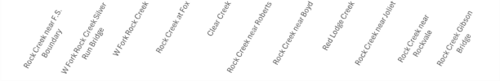
Site Name | Plot Order
Rock Creek near F.S. Boundary | 1
W Fork Rock Creek Silver Run Bridge | 2
W Fork Rock Creek | 3
Rock Creek at Fox | 4
Clear Creek | 5
Rock Creek near Roberts | 6
Rock Creek near Boyd | 7
Red Lodge Creek | 8
Rock Creek near Joliet | 9
Rock Creek near Rockvale | 10
Rock Creek Gibson Bridge | 11
Notes:
Full site names are shown, however, in boxplots. Sites are ordered left to right, upstream to downstream. The order they appear corresponds with the site numbering.

Slide 8
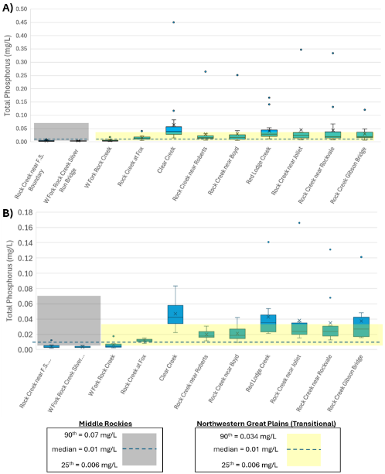
Site Name | Plot Order
Rock Creek near F.S. Boundary | 1
W Fork Rock Creek Silver Run Bridge | 2
W Fork Rock Creek | 3
Rock Creek at Fox | 4
Clear Creek | 5
Rock Creek near Roberts | 6
Rock Creek near Boyd | 7
Red Lodge Creek | 8
Rock Creek near Joliet | 9
Rock Creek near Rockvale | 10
Rock Creek Gibson Bridge | 11
Notes:
So it’ll end up looking something like this.

Slide 9
Site Name | Plot Order
Rock Creek near F.S. Boundary | 1
W Fork Rock Creek Silver Run Bridge | 2
W Fork Rock Creek | 3
Rock Creek at Fox | 4
Clear Creek | 5
Rock Creek near Roberts | 6
Rock Creek near Boyd | 7
Red Lodge Creek | 8
Rock Creek near Joliet | 9
Rock Creek near Rockvale | 10
Rock Creek Gibson Bridge | 11
Notes:
Several plots have shading and/or dashed horizontal lines like this. Shaded boxes represent concentrations observed at reference sites within the respective ecoregion during the growing season. The lower extent of the shading is the 25th percentile of reference site observations, the upper extent of shading at the 90th percentile, and the dashed line is the median observed concentration.

Slide 10
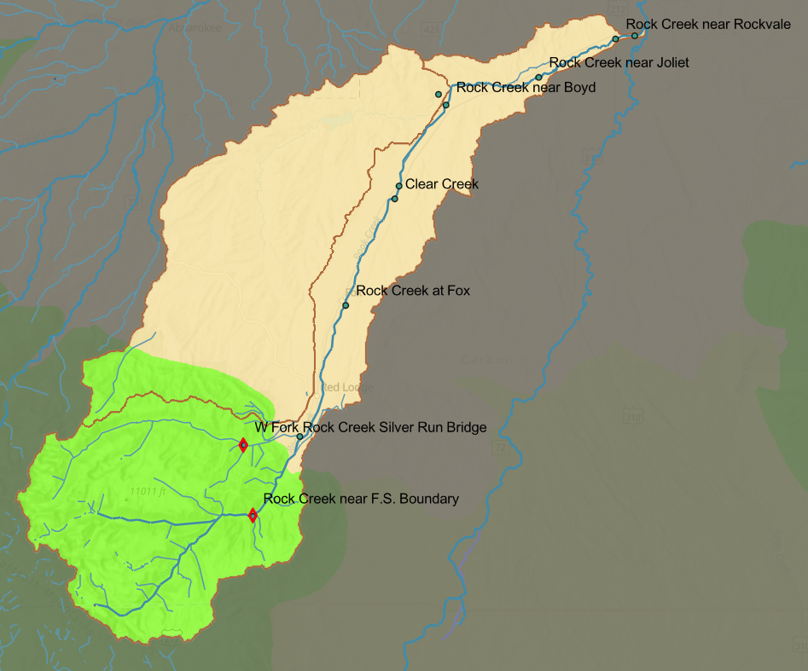
Northwestern Great Plains
Level III Ecoregions
Middle Rockies
Notes:
Here’s a map showing the ecoregion boundaries.

Slide 11
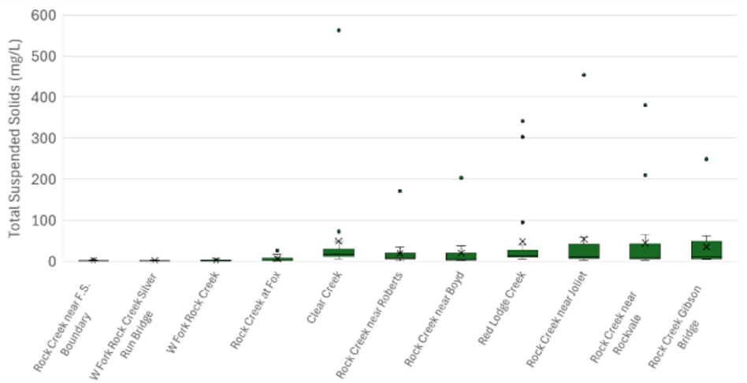
Figure 18: Total Suspended Solids by Site
TSS varied across sites. Downstream sites showing higher concentrations
The three uppermost sites had the lowest median TSS concentrations (1.0 to 1.4 mg/L)
Clear Creek showed the highest mean and median, likely due to land-uses such as ditches

Slide 12
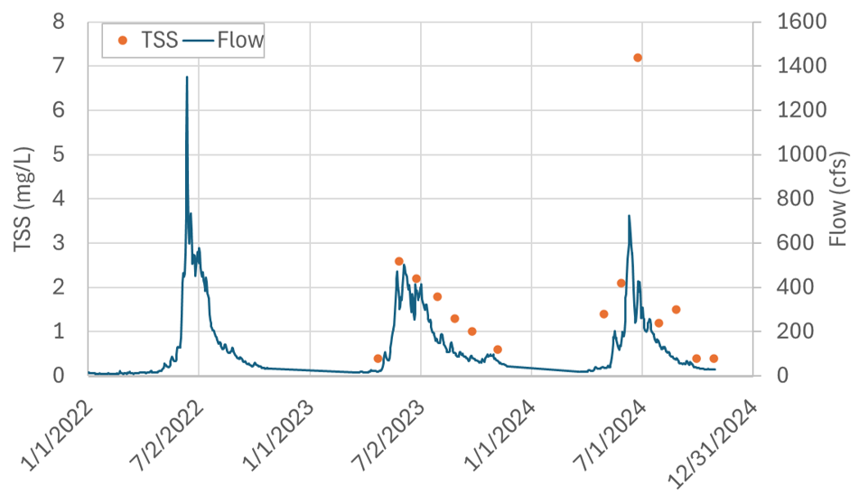
Figure 19. Total Suspended Solids and Flow for Rock Creek at Silver Run Bridge
TSS concentrations increased during high-flow events
TSS concentrations at Silver Run Bridge ranged from 0.4 to
7.2 mg/L with daily discharge values ranging from 20 to 428 cfs
Discharge exhibits seasonal patterns and baseflow periods showed lower TSS

Slide 13
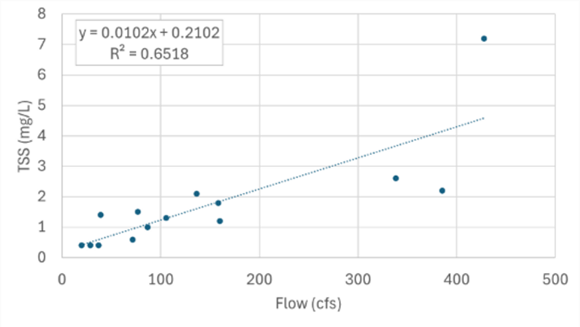

Figure 20. Regression of Total Suspended Solids and Flow for Rock Creek at Silver Run Bridge
A significant positive relationship was observed between discharge and TSS
(p < 0.001)
Figure 19:
Flow explains a substantial portion of variability in suspended solids

Slide 14
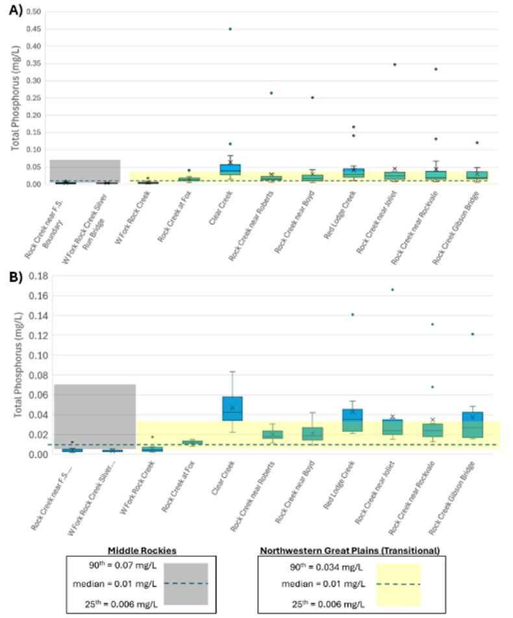
Figure 14: Total Phosphorous by Site
TP ranged from non-detects to 0.45 mg/L
Headwater sites had very low median TP at <0.007 mg/L
Clear Creek showed the highest median, mean, and outlier concentrations

Slide 15
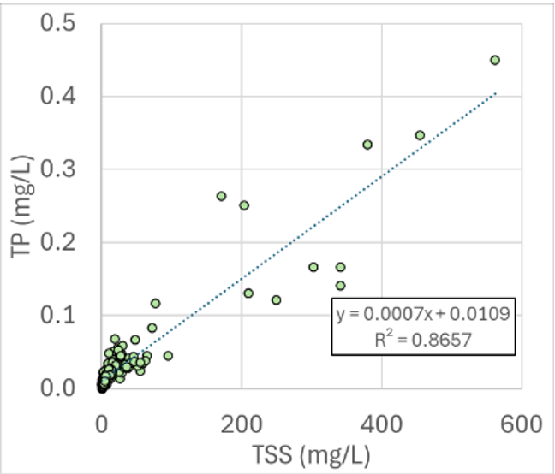
Figure 15: Total Phosphorus Vs Total Suspended Solids
Regression shows a strong positive relationship (p < 0.001)
Indicates phosphorous is largely transported by suspended solids

Slide 16
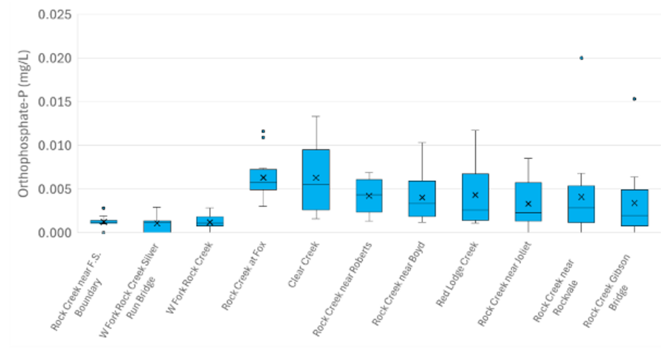
Figure 16: Orthophosphate by Site
Concentrations ranged from non-detects to 0.02 mg/L
Headwater sites had the lowest medians (~0.0012 mg/L)
Figure 14: A
Rock Creek at Fox and Clear Creek had the highest means (~0.0063 mg/L)

Slide 17
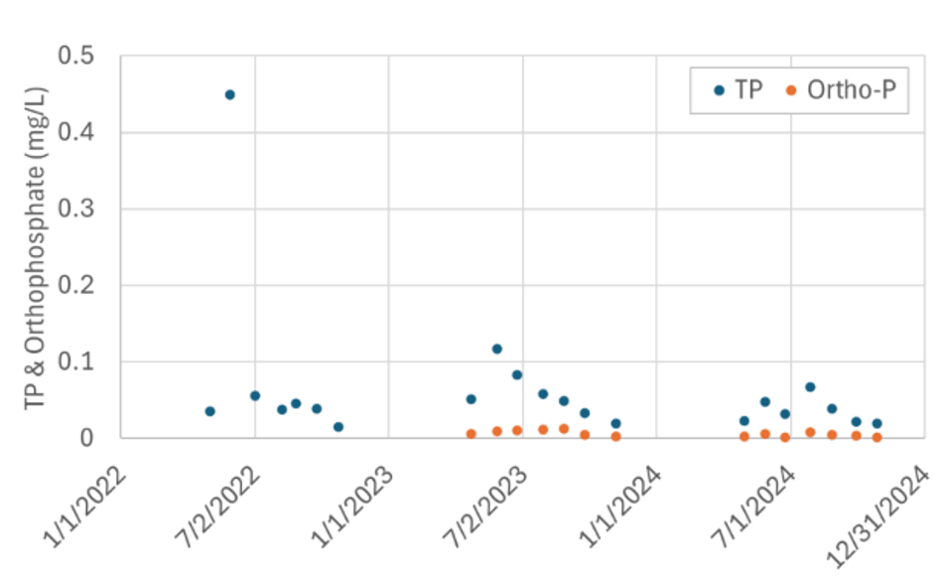
Figure 17: Total Phosphorous and Orthophosphate at Clear Creek
TP ranged from 0.01 to 0.45 mg/L, while Ortho-P ranged from 0.0016 to 0.0133 mg/L
The highest TP was observed in May 2022, while the highest Ortho-P was in August 2023
The lowest concentrations are typically in late fall

Slide 18
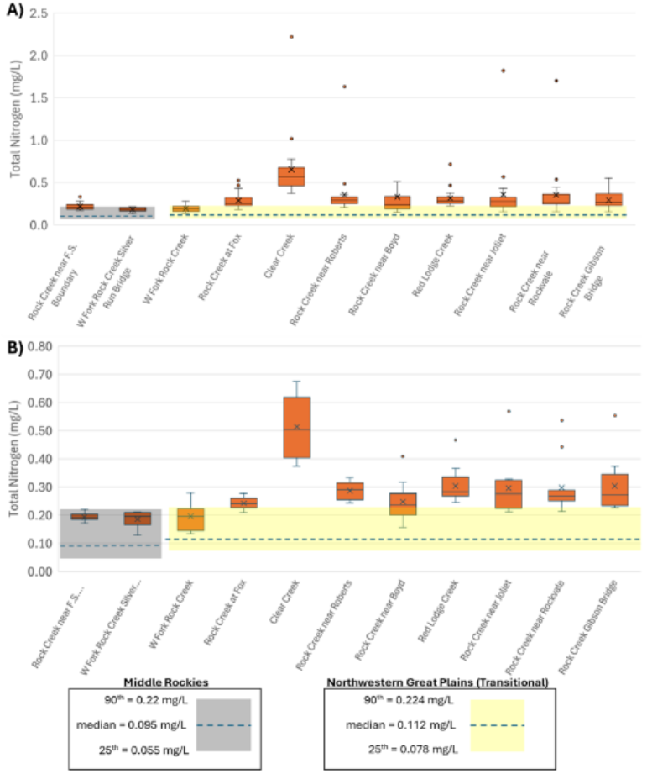
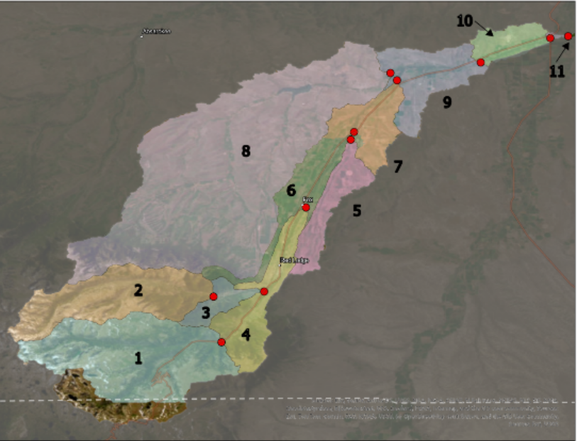
Figure 4. Total Nitrogen by Site
Figure 1. Site and sub-watersheds map

Slide 19
Figure 4. Total Nitrogen by Site
Figure 1. Site and sub-watersheds map
Notes:
Total nitrogen (TN) concentrations ranged from 0.13 mg/L to 2.22 mg/L across the sites (Figure 4). The three uppermost sampling sites (Rock Creek near F.S. Boundary, WF Rock Creek at Silver Run Bridge, and WF Rock Creek) had lower median TN concentrations (0.19 to 0.20 mg/L) than the downstream sites (0.24 to 0.57 mg/L). The highest median (0.57 mg/L), mean (0.66 mg/L), and outlier (2.22 mg/L) concentrations were observed at Clear Creek. shading is for “reference sites” during “growing season” months, which is “July August and September.”

Slide 20
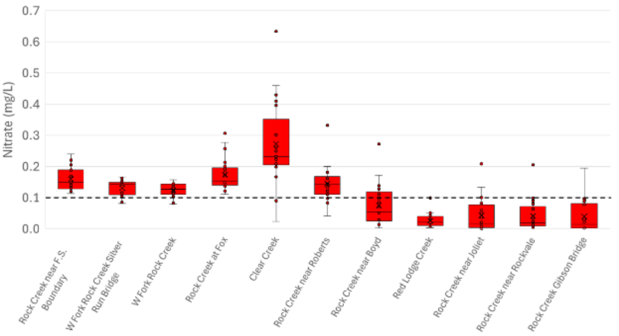
Figure 4. Total Nitrogen by Site
Figure 5. Nitrate-N by site
Notes:
Nitrate-N concentrations ranged from non-detect (<0.0015 mg/L) to 0.63 mg/L (Figure 5). All sites besides Red Lodge creek had a concentration above the 0.1 mg/L threshold . The upstream most six sites had a median and mean concentration above the threshold, while the lower five sites were below this threshold. Clear Creek had the highest median (0.23 mg/L) and mean (0.27 mg/L) concentrations, and the largest variability in concentrations with a range of 0.02 to 0.63 mg/L.

Slide 21
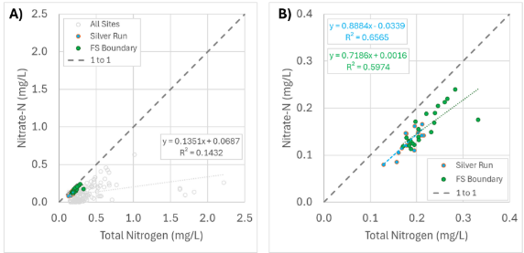
Figure 6. Nitrate versus Total Nitrogen
Notes:
Across all sites and samples, only 14% of variability in nitrate is correlated to variability in TN. However, all five samples with TN greater than 1.5 were collected on May 30th of 2022 (from Rock at Joliet, Rockvale, Roberts, Boyd, and Clear Creek; Figure 6A). If those five observations are omitted from the regression, the r² value increases to 0.35 and the slope increases to 0.42. Nitrate relative to TN is more consistently high for the two headwaters sites where the regression slopes indicate ~88% of TN at Silver run is nitrate and ~72% at FS Boundary (Figure 6B).

Slide 22
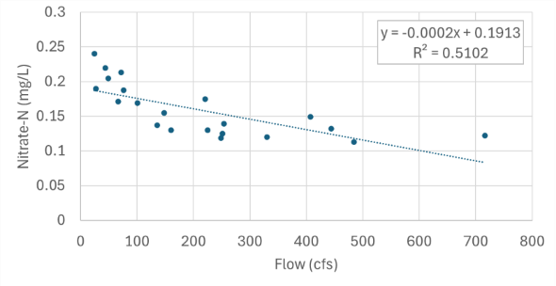
Figure 9. Regression of Nitrate-N versus Flow for Rock Creek near F.S. Boundary
Notes:
This regression shows flow vs Nitrate at the FS Boundary site. This depicts a negative relationship meaning and an r^2 value of 0.51, meaning that ~51% of the variability in Nitrate can be predicted by variation in flow. Higher flow leads to lower nitrate concentrations and vice versa.

Slide 23
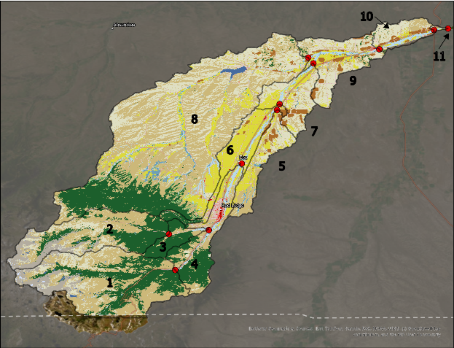
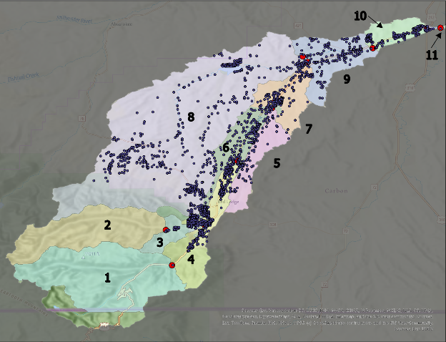
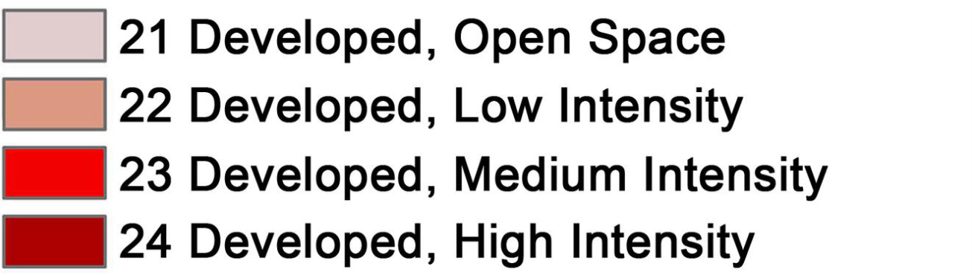
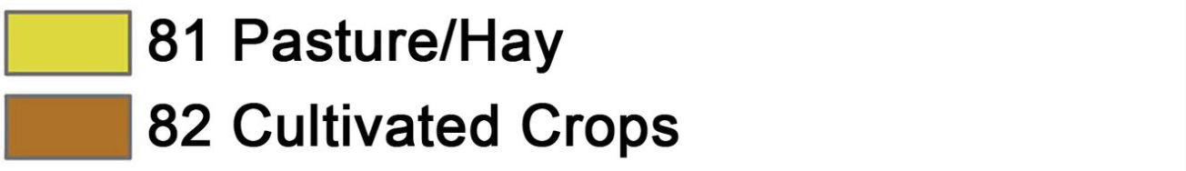
Figure 3. Septic map
Figure 2. Land Use Map
Notes:
The sample site sub-watershed with the highest septic density was Rock Creek at Fox, with 4.4 septic systems per 100 acres, while no septic systems were identified upstream from the two headwater sites (Table 2). Rock Creek near Gibson Bridge had the highest number of septic systems across watersheds at 2,227, which is implicit in the calculation because the Gibson Bridge watershed encompasses all other site sub-watersheds. The Clear Creek sub-watershed had the highest percent developed area at 4.8%, and the headwater sites had the lowest percent development areas (0.5 to 0.6%). Percent pasture land ranged from zero for headwater sites to 25% for the Clear Creek site sub-watershed. Cultivated crop area across the sample site watersheds ranged from zero at the two headwater sites to 7.1% for the Clear Creek site.

Slide 24
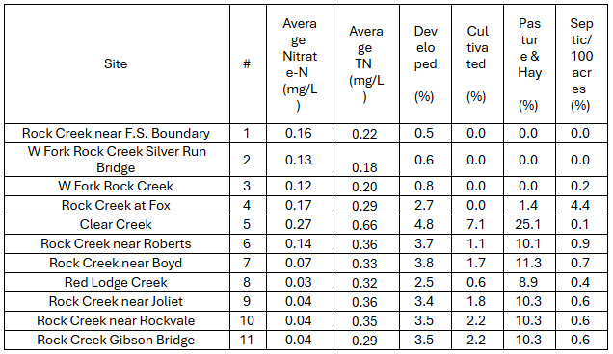
Table 2. Land use for each sample site sub-watershed

Slide 25
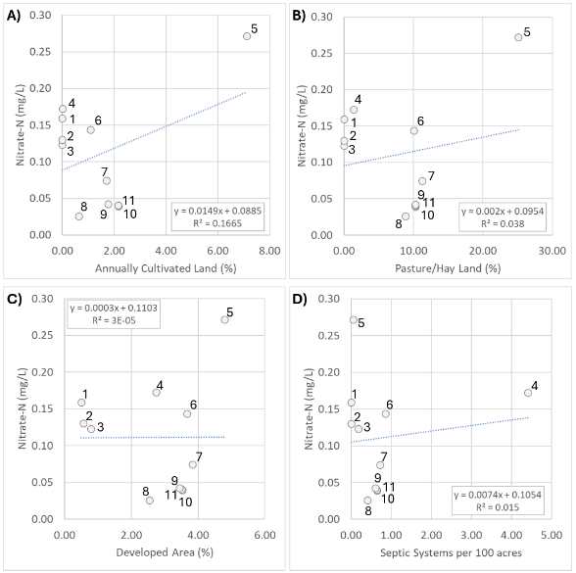
Figure 12. Nitrate-N versus land use for each sample site watershed
Notes:
There were no significant relationships between land use characteristics and mean nitrate concentrations for the 11 site sub-watersheds (Figure 18; all p values > 0.1).

Slide 26
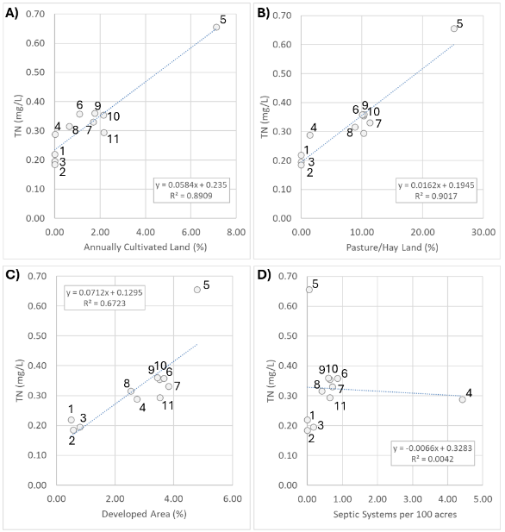
Figure 13. TN versus land use for each sample site watershed
Figure 12. Nitrate-N versus land use for each sample site watershed
Notes:
In contrast, mean TN concentration had a significant positive correlation to three of the four land use metrics assessed (cultivated crops, pasture/hay, and developed land). Septic density did not have a significant relationship with the mean total N concentrations.

Slide 27


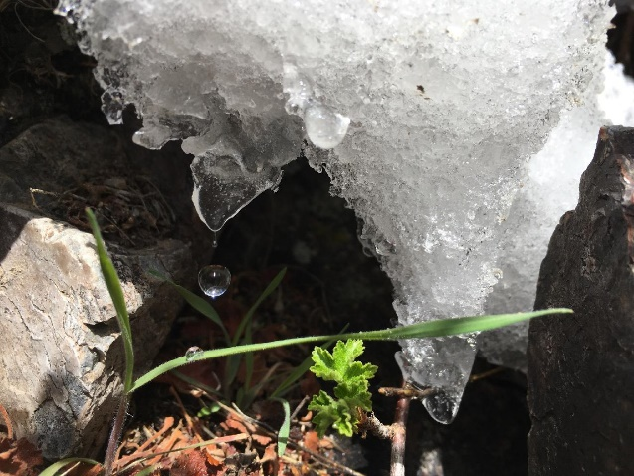
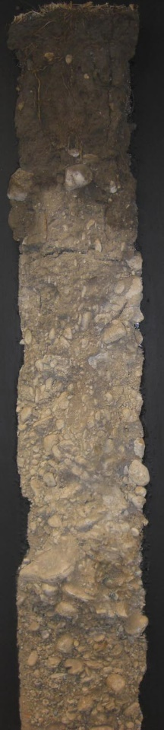
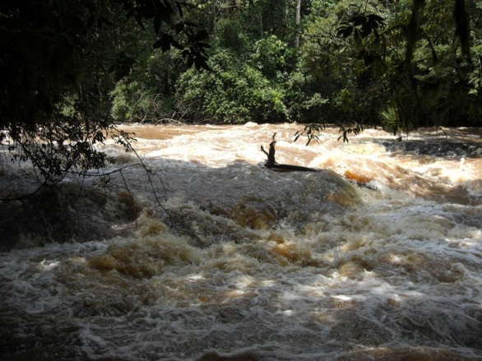
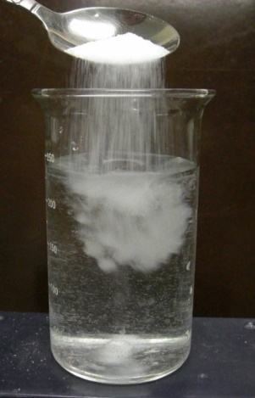
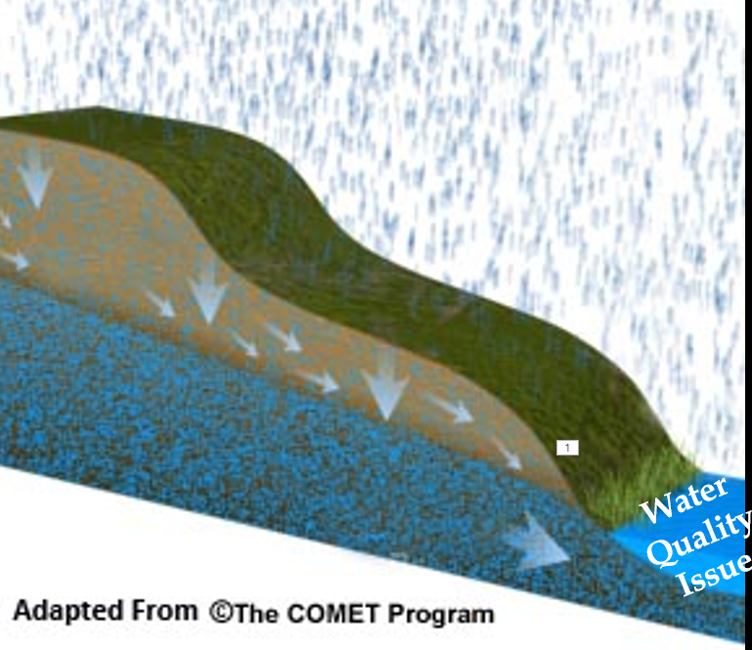
Water Quality - Patterns in Nature
Sediment
(Particulate)
Flow
Salinity
(Dissolved)
Winter
Spring
Summer
Fall

Slide 28
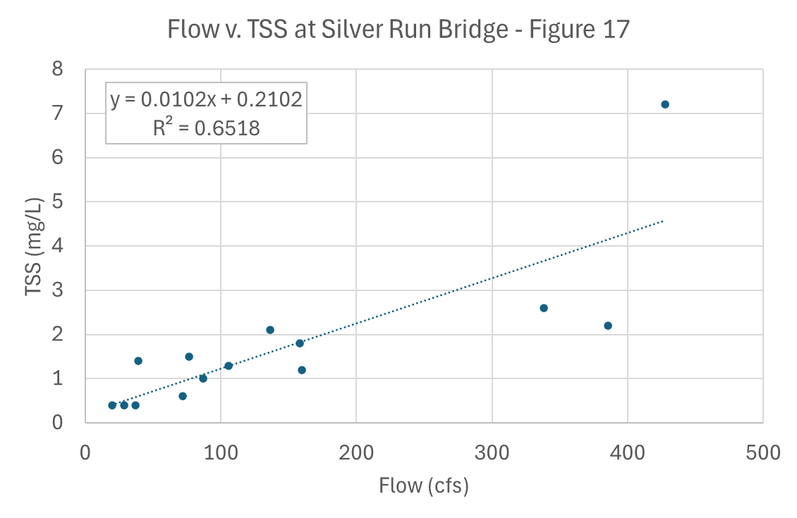
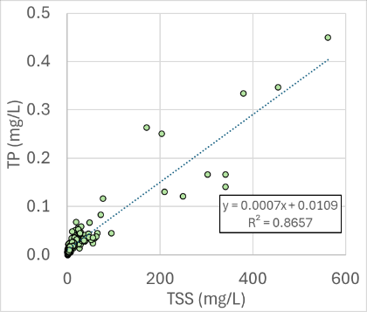
Water Quality - Patterns in Nature
Sediment
(Particulate)
Flow
Salinity
(Dissolved)
Winter
Spring
Summer
Fall

Slide 29
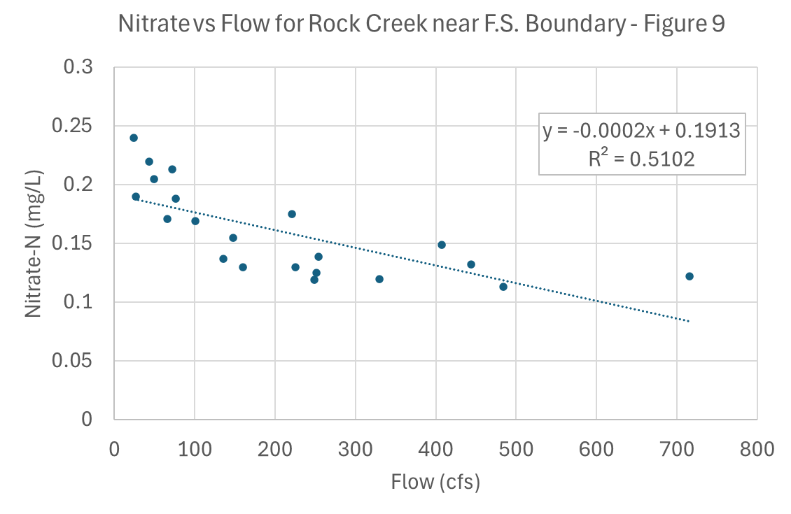
Water Quality - Patterns in Nature
Sediment
(Particulate)
Flow
Salinity
(Dissolved)
Winter
Spring
Summer
Fall

Slide 30
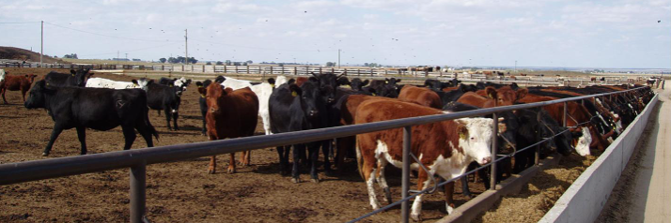
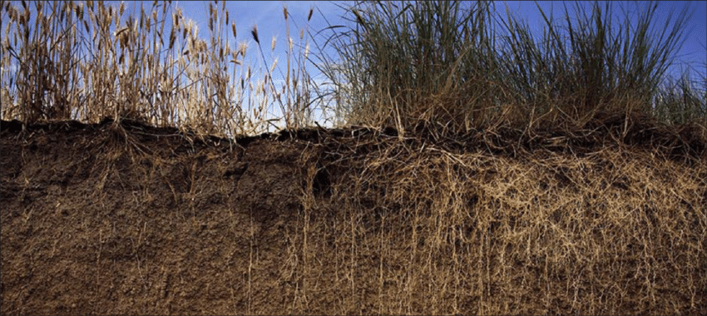
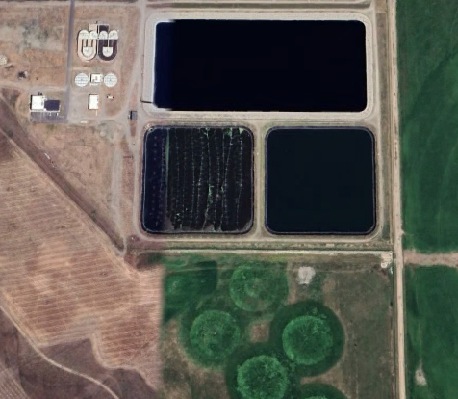
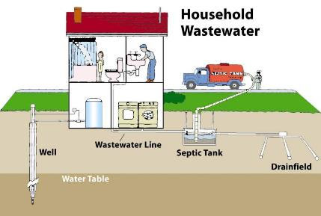
Nitrate Sources to Groundwater
Concentrated livestock waste
Farming (primarily annually cultivated crops)
Municipal wastewater
Septic
Annual
Perennial
Few roots part of year
Many roots all year
more N fertilizer
less N fertilizer

Slide 31
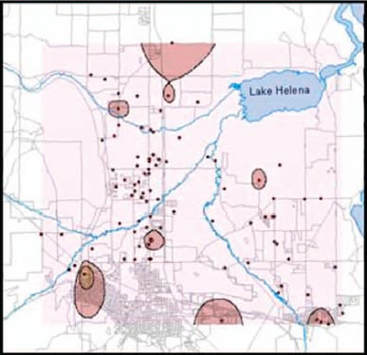

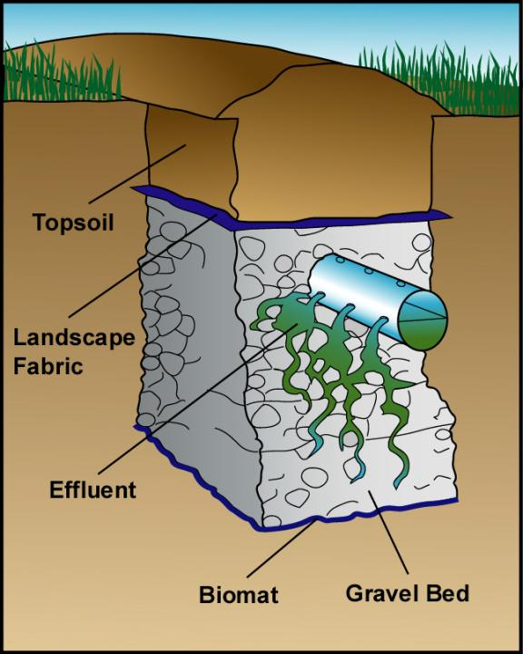
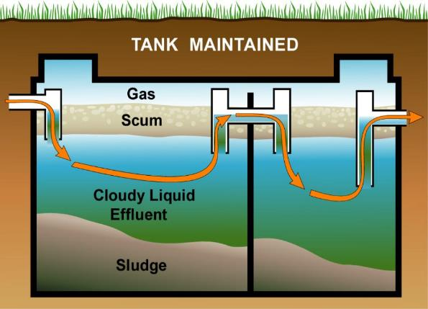
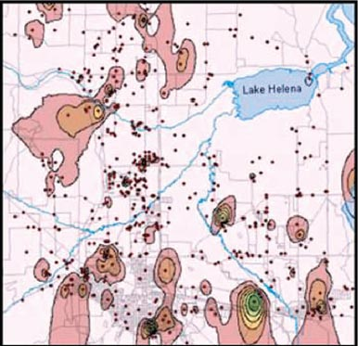
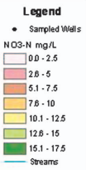
Septic Nitrogen Treatment
Nitrate – Helena, MT 1970
Nitrate – Helena, MT 2000
Drake and Bauder, 2005 Ground Water Monitoring and Remediation

Slide 32
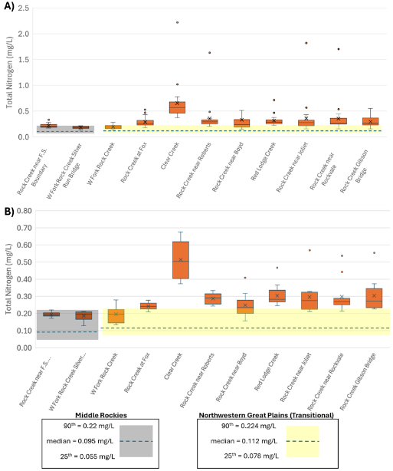
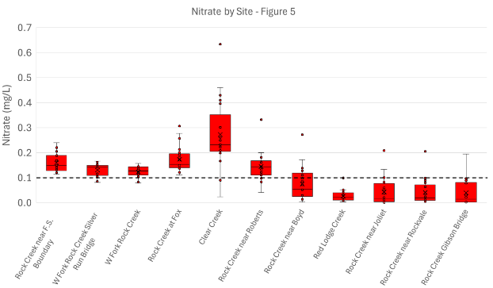
Total Nitrogen
Nitrate-N

Slide 33
Carbon County Resource Council
2022-2024 Rock Creek
Water Quality Data Analysis
Samuel Gabrielson & Wesley Cousin
G Jawer
Dr. Adam Sigler
Notes:
Thank you for joining us today! This work has been conducted as part of a one semester Montana State University undergraduate research course, led by Dr. Adam Sigler with support from me, Gabrielle Jawer. Samuel Gabrielson and Wesley Cousin are the undergraduate students assigned to the CCRC monitoring program for the course, and they’ve done some amazing work this semester.
This project was conducted in consultation with representatives of the Carbon County Resource Council, a group of citizens who care about the responsible use of water resources with the goal of finding solutions to environmental issues that impact quality of life in proximity to Rock Creek, and it was supported by funding from Montana Department of Environmental Quality (MDEQ); Abbie Ebert with MDEQ provided valuable comments on report drafts.
Rock Creek is a 55-mile-long tributary to the Clarks Fork Yellowstone River. It begins high in the Absaroka Beartooth Wilderness and flows through National Forest Land, as well as the towns of Red Lodge, Fox, Roberts, Joliet, and Boyd. It also flows through multiple subdivisions, farms, and ranches before merging with the Clarks Fork Yellowstone River south of Laurel, MT. Rock Creek runs along highway 212 for most of its length with adjacent land uses including residential development, cultivated crops, and pasture/hay land. Red Lodge Creek and Clear Creek are additional tributaries covered under this project. Flows in Red Lodge Creek are affected by storage and release from the Cooney Reservoir dam. In late summer, Rock Creek sometimes experiences dewatering along the reach from Rockvale downstream to its confluence with the Clarks Fork Yellowstone River.

