Slide 1
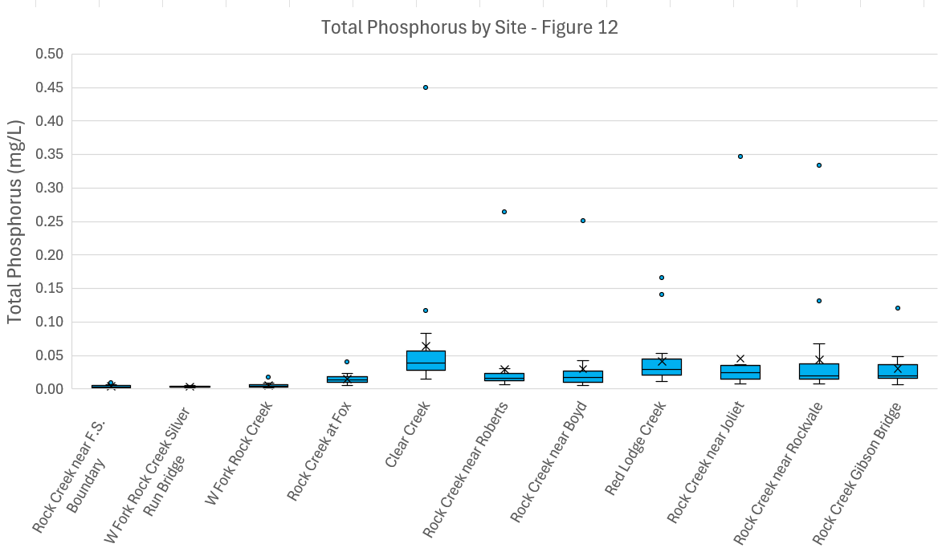
Middle Rockies
Northwestern Great Plains (Transitional)
90th = 0.07 mg/L
90th = 0.034 mg/L
median = 0.01 mg/L
median = 0.01 mg/L
25th = 0.006 mg/L
25th = 0.006 mg/L
Notes:
Middle Rockies (EPA Region 10) - SRB and FSB
Northwestern Great Plains (EPA region 8) – WFRC, Fox, Clear Crk, Roberts, Red Lodge Crk, Boyd, Joliet, Rockvale, Gibson

Slide 2
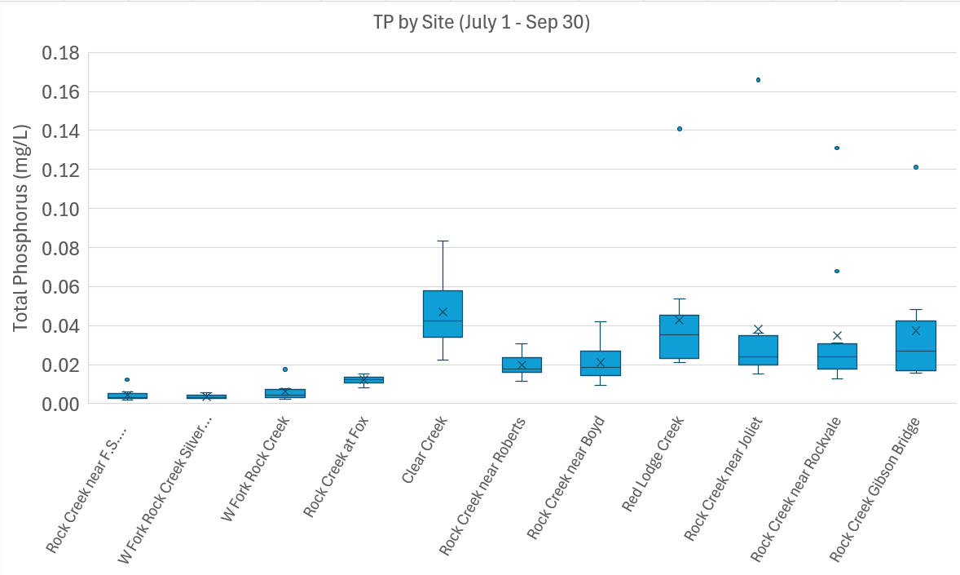
Middle Rockies
Northwestern Great Plains (Transitional)
90th = 0.07 mg/L
90th = 0.034 mg/L
median = 0.01 mg/L
median = 0.01 mg/L
25th = 0.006 mg/L
25th = 0.006 mg/L
Notes:
Middle Rockies (EPA Region 10) - SRB and FSB
Northwestern Great Plains (EPA region 8) – WFRC, Fox, Clear Crk, Roberts, Red Lodge Crk, Boyd, Joliet, Rockvale, Gibson

Slide 3
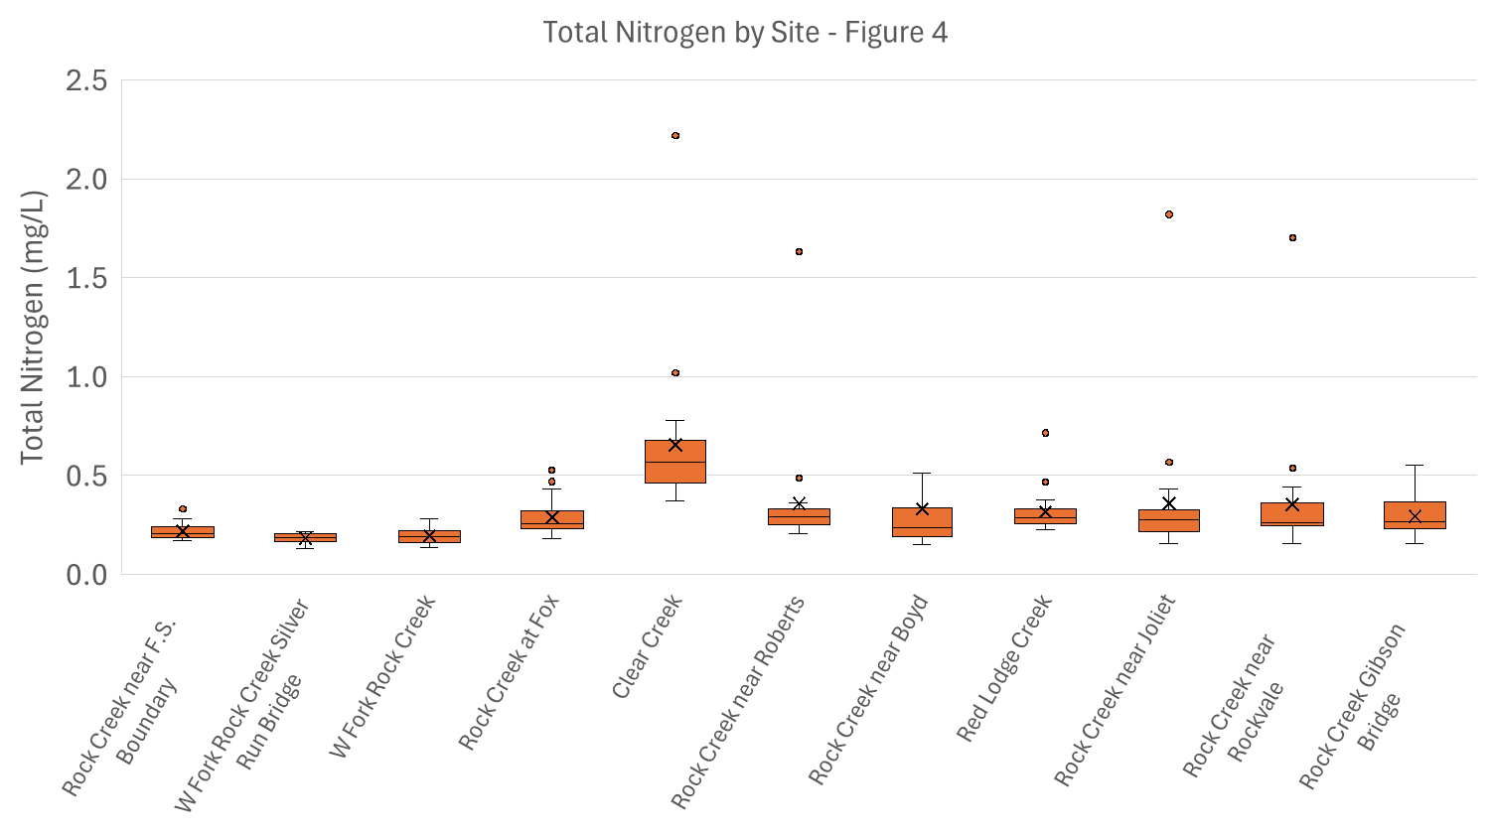
Middle Rockies
Northwestern Great Plains (Transitional)
90th = 0.22 mg/L
90th = 0.224 mg/L
median = 0.095 mg/L
median = 0.112 mg/L
25th = 0.055 mg/L
25th = 0.078 mg/L

Slide 4
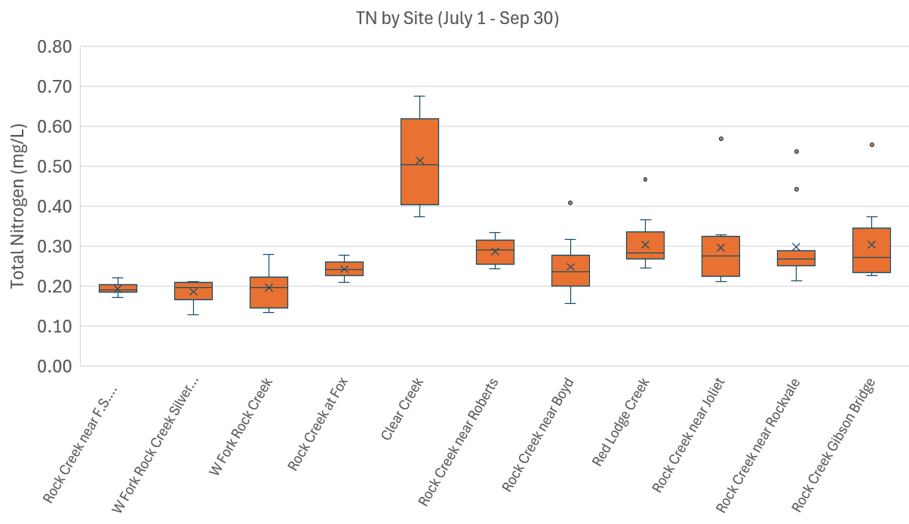
Middle Rockies
Northwestern Great Plains (Transitional)
90th = 0.22 mg/L
90th = 0.224 mg/L
median = 0.095 mg/L
median = 0.112 mg/L
25th = 0.055 mg/L
25th = 0.078 mg/L

Slide 5
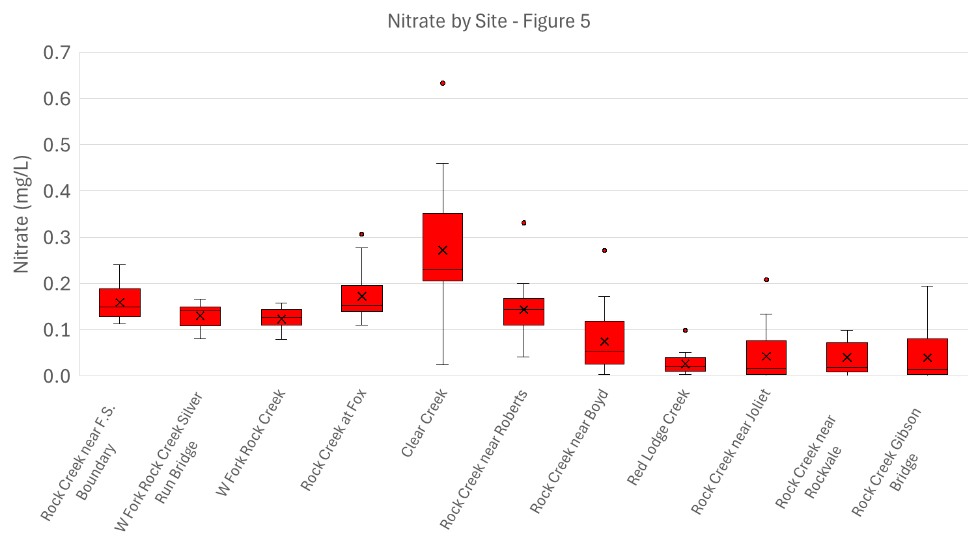
Notes:
Nitrate 0.1

Slide 6
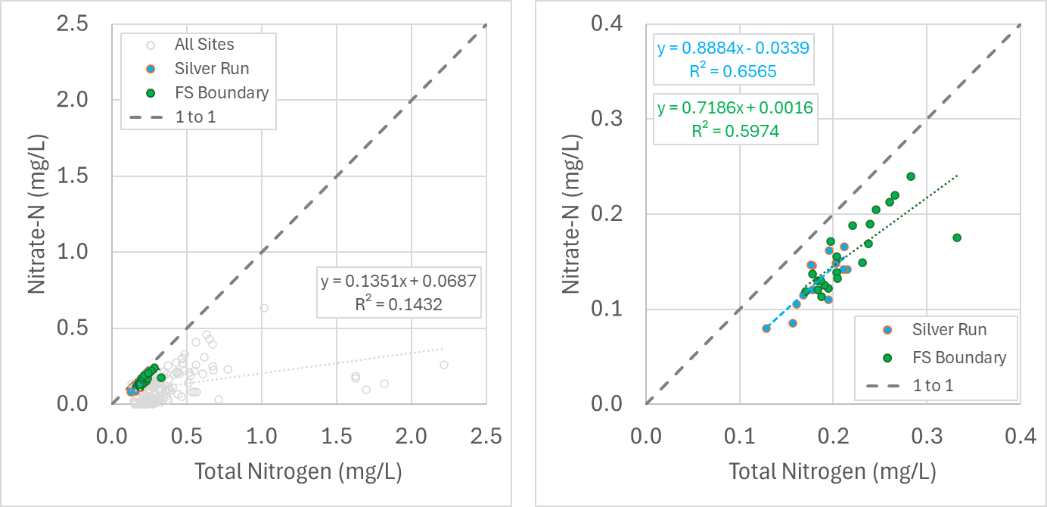
A)
B)

Slide 7
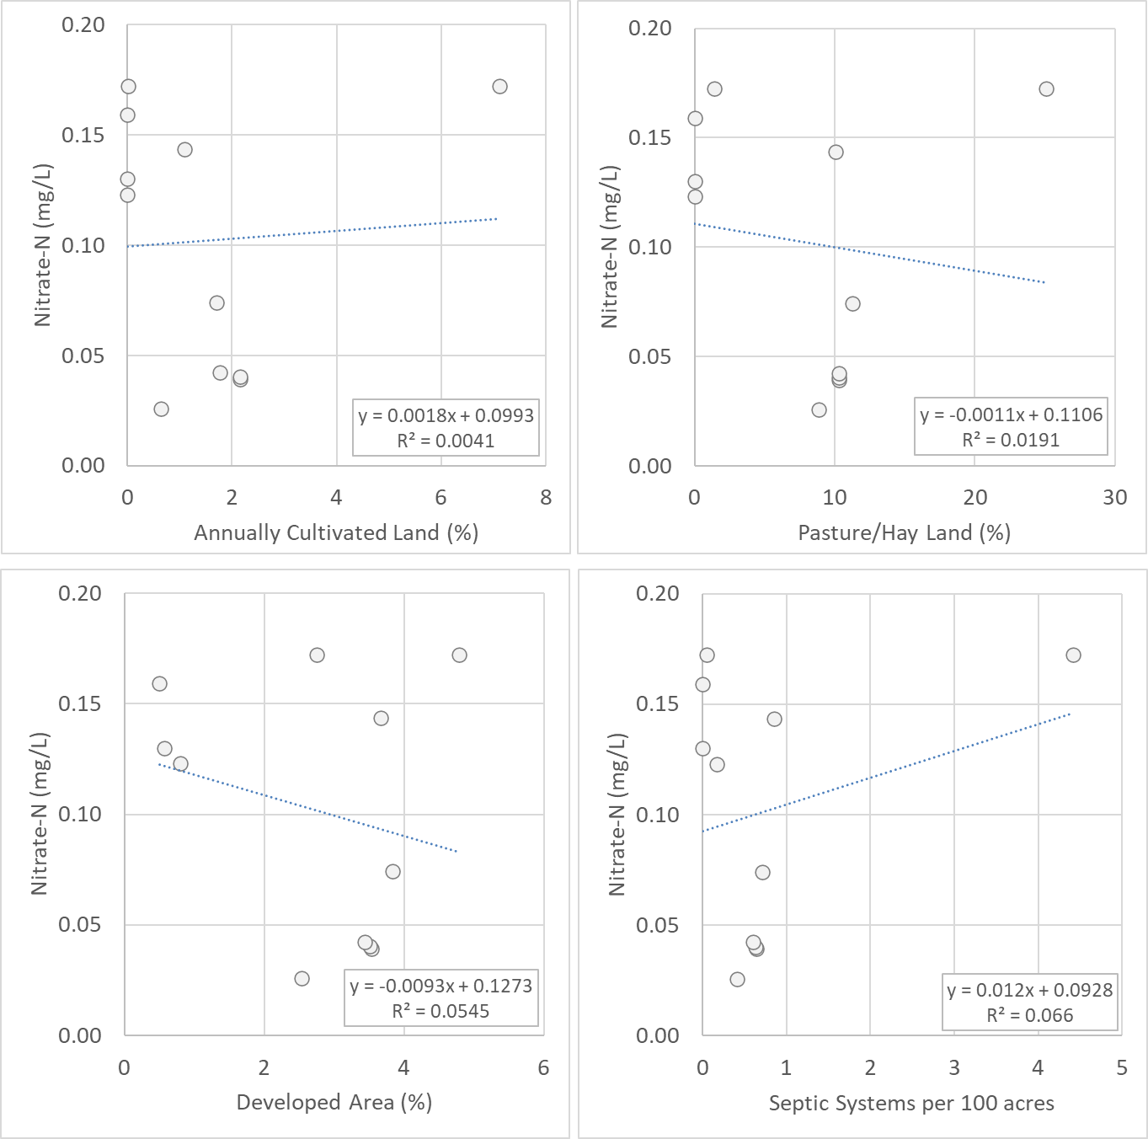
A)
B)
4
5
4
5
1
1
6
6
1
2
2
3
3
2
7
3
7
9
11
9
4
8
10
11
8
10
5
6
C)
D)
7
4
5
5
4
8
1
1
6
6
2
2
3
3
9
10
7
7
9
9
11
11
11
8
10
10
8

Slide 8
A)
B)
5
5
1
6
9
10
10
9
2
4
8
7
11
6
7
3
4
8
11
1
1
3
3
4
2
2
5
6
D)
7
C)
8
5
5
9
10
9
6
10
8
10
7
9
6
11
7
1
4
8
11
4
11
3
1
3
2
2

Slide 9
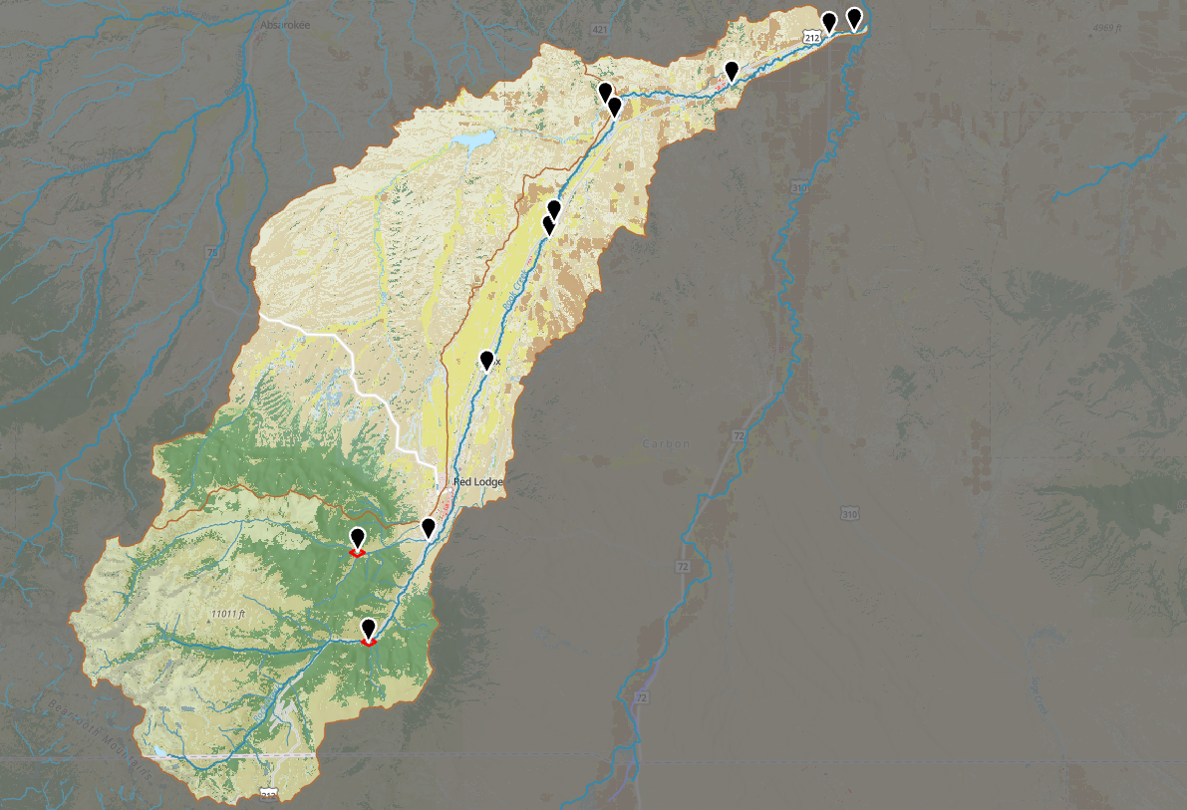
Rock Creek Gibson Bridge (11)
Rock Creek near Rockvale (10)
Red Lodge Creek (8)
Rock Creek near Joliet (9)
Rock Creek near Boyd (7)
Clear Creek (5)
Rock Creek near Roberts (6)
Rock Creek at Fox (4)
W Fork Rock Creek (3)
W Fork Rock Creek Silver Run Bridge (2)
Rock Creek near F.S. Boundary (1)

