Slide 1
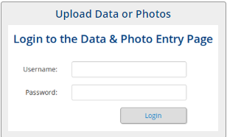
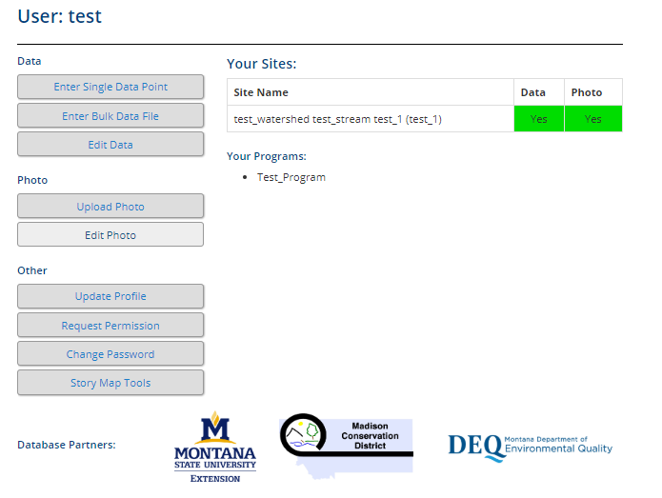
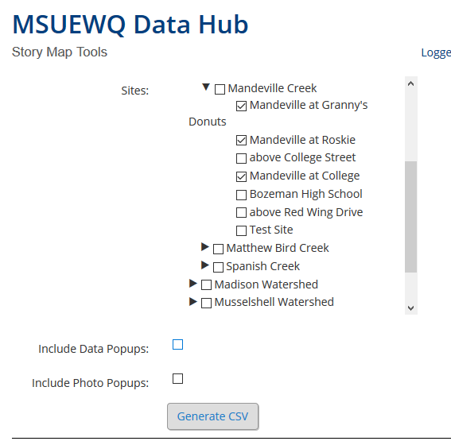
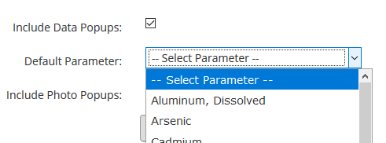
MSUEWQ Data Hub Story Map Tool
The guidance below illustrates how site data can be downloaded from the Data Hub as a .csv file. The downloaded data is easily transferable to mapping tools such as GIS embedded maps and GIS Story Maps.
Download Data Site info to a .csv file
Contact ExtensionWater@montana.edu to obtain a username and password for this section if you do not already have one.
Navigate to the Data Hub (google Montana Extension Water; on MSUEWQ homepage, click on Data Hub icon)
Click on “Upload Data or Photos”
Login using your username and password
Click “Story Map Tools”
Select the sites you would like to download site data for
Selecting “Include Data Popups” includes a link to the data hub data viewer for each downloaded site. The “default parameter” selection determines what parameter the link will direct to.
Selecting “Include Photo Popups” includes a link to the data hub photo viewer for each site selected.
Click “Generate CSV” and save the file.
The downloaded .csv file will include the following
Watershed Name
Stream Name
Site Name
Site ID
Site Description
Site Lat and Long
Data Viewer and Photo Viewer links if selected
An example Story Map and Embedded Map are available on the
Data Hub Mapping Tools Web Page
Guidance for making Story Maps and Embeddable Maps:
MSUEWQ Story Map Resources Web Page
Adding data as a csv or shapefile to an ArcOnline Map Video
How to add an ArcOnline map to a Map Journal Story Map Video

