Slide 1
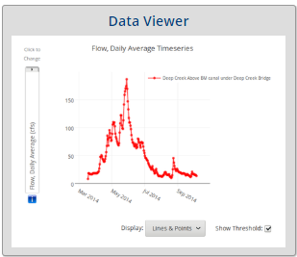
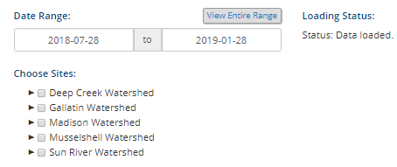
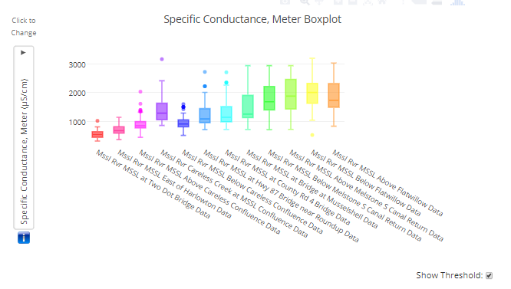
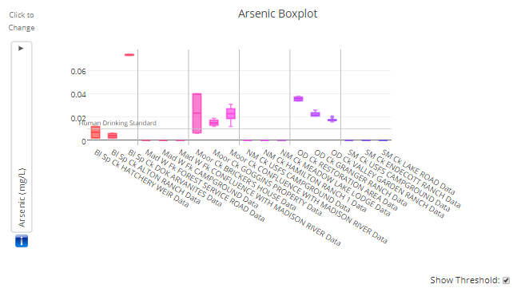
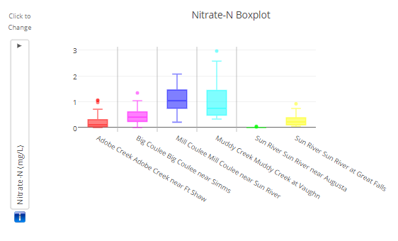
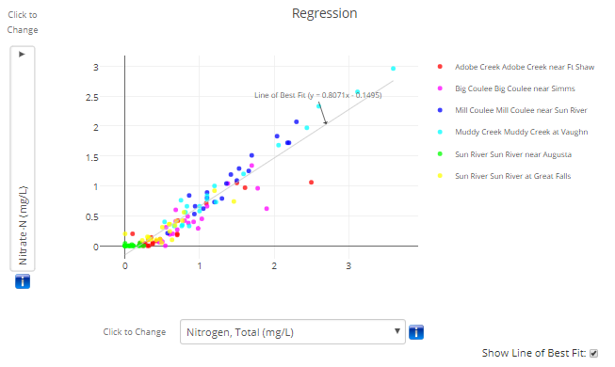
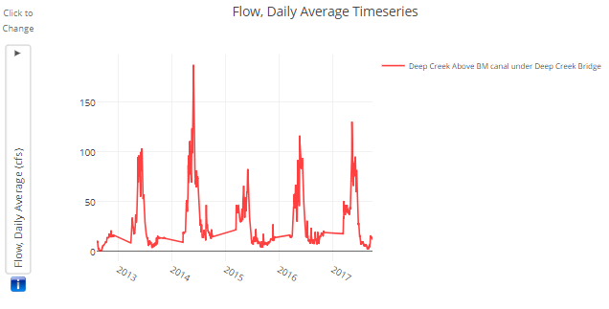
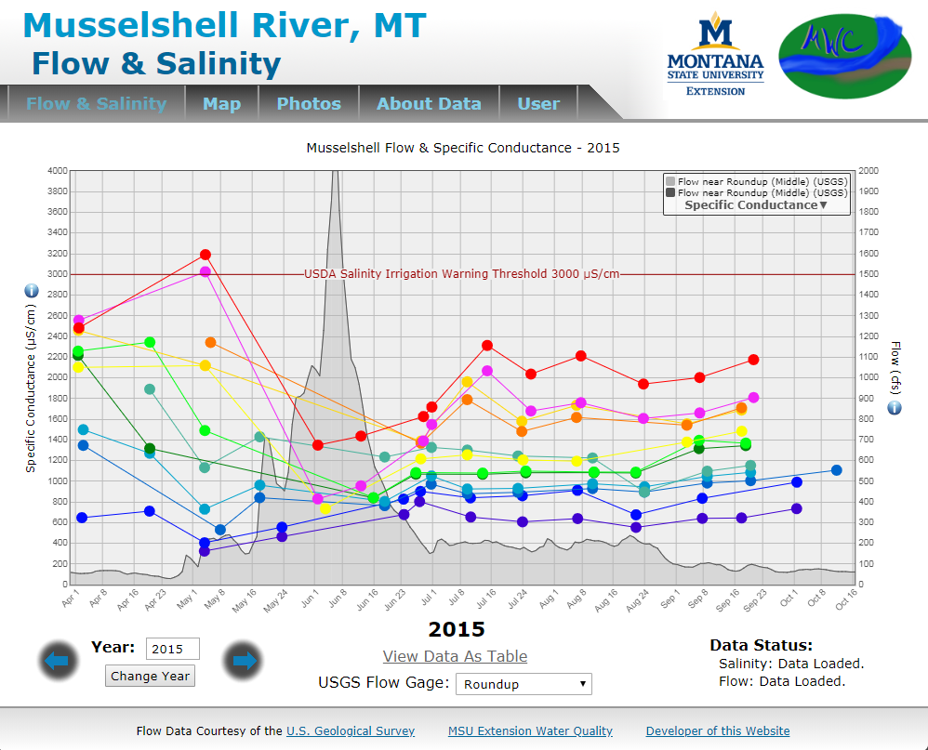
MSUEWQ Data Hub - Exercise 1 Explore Data
Navigate to the Data Hub (google Montana Extension Water; on MSUEWQ homepage, click on Data Hub icon)
Click on “Data Viewer”
Use the drop down arrows under “Choose Sites” to select sites to view data for.
In the “Date Range” section, choose “View Entire Range” to see all data available for your selected sites.
Note the “Loading Status.” Over a slower internet connection with a lot of users on the Wifi it may take a few moments to load.
Data Explore 1: Musselshell Up to Downstream
Select the “Musselshell River”
Select “boxplot”
What is the pattern in specific conductance moving from left to right across the plot? Why do you think this pattern exists?
Data Explore 2: Madison Arsenic
Navigate to data for the Madison watershed.
Which site has the highest arsenic?
How many sites have arsenic above the drinking water standard?
Why do some sites have high arsenic in the Madison?
Data Explore 3: Sun River Nutrients
Navigate to data for the Sun River.
What site has the highest nitrate concentration (easiest to see with boxplot).
What is the relationship between nitrate and total nitrogen (use the regression plot to see this)? What does this mean about the dominant form of nitrogen in the Sun?
Data Explore 4: Deep Creek Flows
Navigate to data for Deep Creek.
Use the dropdowns to select data by site
What day was peak discharge at the “Above Broadwater Missouri Canal” site in 2014? What was the cfs?
Date Explore 5: Musselshell salinity and flow
Navigate back to the MSUEWQ home page and select the thumbnail for “Musselshell Salinity Project”
Toggle through the years and look at the data for 2015.
What is the relationship between Specific Conductance and discharge? Why does this relationship exist?

Slide 2
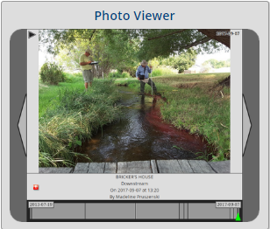
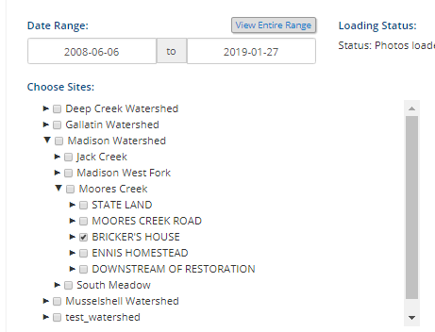
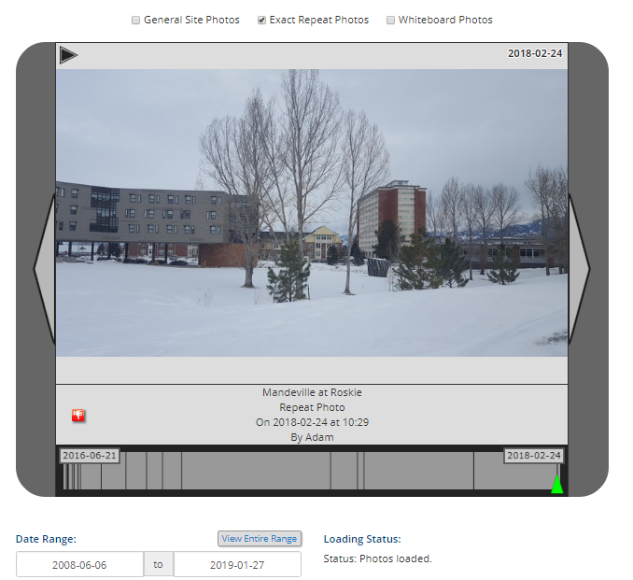
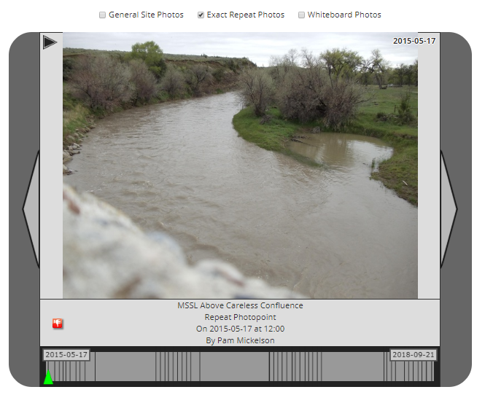
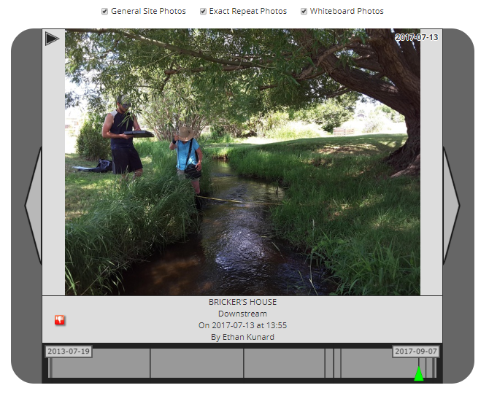
MSUEWQ Data Hub - Exercise 2 Explore Photos
Navigate to the Data Hub (google Montana Extension Water; on MSUEWQ homepage, click on Data Hub icon)
Click on “Photo Viewer”
Use the drop down arrows under “Choose Sites” to select sites to view data for.
In the “Date Range” section, choose “View Entire Range” to see all photos available for your selected sites.
Note the “Loading Status.” Over a slower internet connection with a lot of users on the Wifi it may take a few moments to load.
Photo Explore 1: Mandeville at Roskie
Select the “Gallatin Watershed” and “Mandeville at Roskie”
In the “Date Range” section, select “View Entire Range”
Above the photos, unselect “General” and “Whiteboard Photos”
Press the play arrow to see the slide show.
What date was the sod installed at the new dorms in the photo?
Photo Explore 2: Musselshell Careless Channel Vegetation
Select the “Musselshell Watershed” and “MSSL Above Careless Confluence”
In the “Date Range” section, select “View Entire Range”
Above the photos, unselect “General” and “Whiteboard Photos”
Press the play arrow to see the slide show.
There is a small off channel pond on the right of the photo. What years is it completely separated from the main channel by vegetation?
During what periods does the flow look particularly high at the site?
Photo Explore 3: Madison Flow Measurement
Select the “Madison Watershed”, “Moores Creek” and “Bricker’s House”
In the “Date Range” section, select “View Entire Range”
Above the photos, unselect “General” and “Whiteboard Photos”
Press the play arrow to see the slide show.
What days can you verify that discharge was measured at the site?

Slide 3
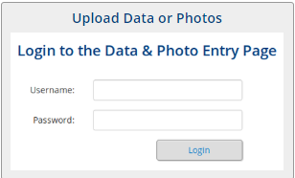
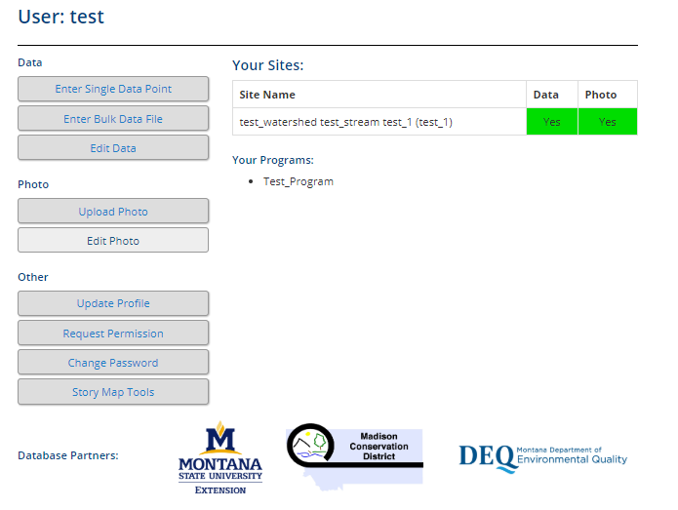
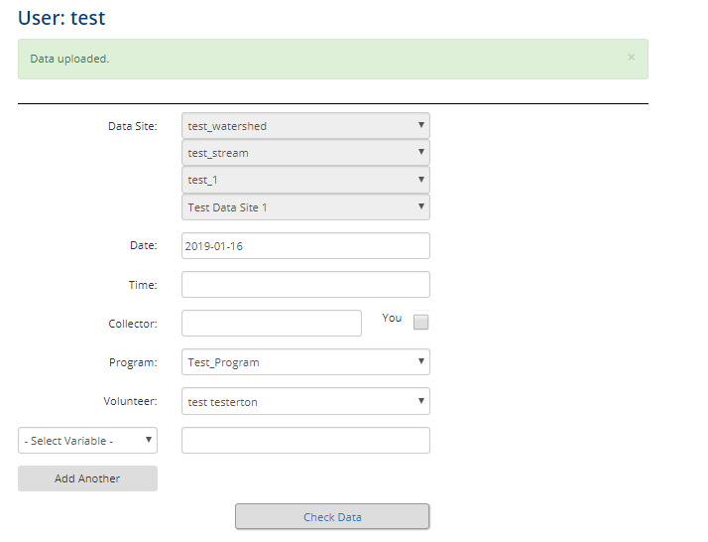
MSUEWQ Data Hub - Exercise 3 Upload Data
Upload test data
Contact ExtensionWater@montana.edu to obtain a test username and password for this section
Navigate to the Data Hub (google Montana Extension Water; on MSUEWQ homepage, click on Data Hub icon)
Click on “Upload Data or Photos”
Login using the test username and password
Click “enter single data point”
Select a test site and click “upload data”
Select a date and time
Click the “You” box to indicate the data is uploaded by the test user.
Select a variable
Enter a value
Click “Check Data”
If it looks like what you intended, click “yes, upload it”
Check the data you entered is viewable in the Data Hub
At the top of the page, click “MSUEWQ Data Hub” to get back to the main Data Hub page. Or navigate back to it following step 1 above.
Go into the data viewer and select “test_watershed” and look for your data point.

Slide 4
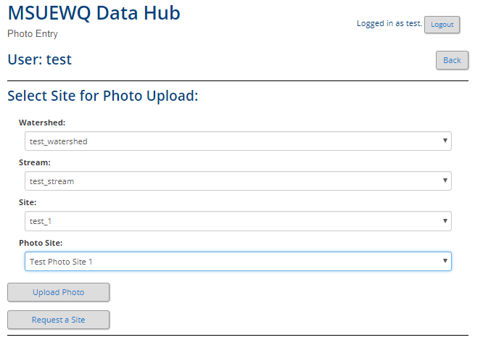
MSUEWQ Data Hub - Exercise 4 Upload Photo
Upload test photo
Contact ExtensionWater@montana.edu to obtain a test username and password for this section
Navigate to the Data Hub (google Montana Extension Water; on MSUEWQ homepage, click on Data Hub icon)
Click on “Upload Data or Photos”
Login using the test username and password
Click “upload photo”
Select a test site under “Photo Site” and click “upload photo”
Select a date and time
Click the “You” box to indicate the data is uploaded by the test user.
Add a comment if you like
Click “Choose File” and navigate to the photo on your phone or laptop.
You can crop the file if you like by clicking on “crop”
Click “Check Photo”
If it looks like what you intended, click “yes, upload it”
Check the photo you entered is viewable in the Data Hub
At the top of the page, click “MSUEWQ Data Hub” to get back to the main Data Hub page. Or navigate back to it following step 1 above.
Go into the photo viewer and select “test_watershed” and look for your photo.

